Slide 1
Unittesting

Slide 2
Jasmine
Jasmine-core is the framework we are going to use to create our tests.
Jasmine is a behaviour-driven development framework for testing.
Jasmine also provides mocking.
Notes:
describe, beforeEach, afterEach and it

Slide 3
Karma
Karma is a test runner. It uses a configuration file in order to set the startup file, the reporters, the testing framework, the browser among other things.
Karma opens up the browser in order to run the tests.

Slide 4
Jest
Jest is build on top of Jasmine.

Slide 5
Jest Advantages
Fewer configuration
Better for Continous Integration – faster
Jest is 2x to 3x times faster than Karma testing
Easy debugging
Notes:
Jest is 2x to 3x times faster than karma testing.
Reason?
Karma uses a real browser for running the tests
Jest uses the favourite command line to run its tests + uses JSDOM: is a JavaScript based headless browser

Slide 6
How to start the tests?
ng test

Slide 7
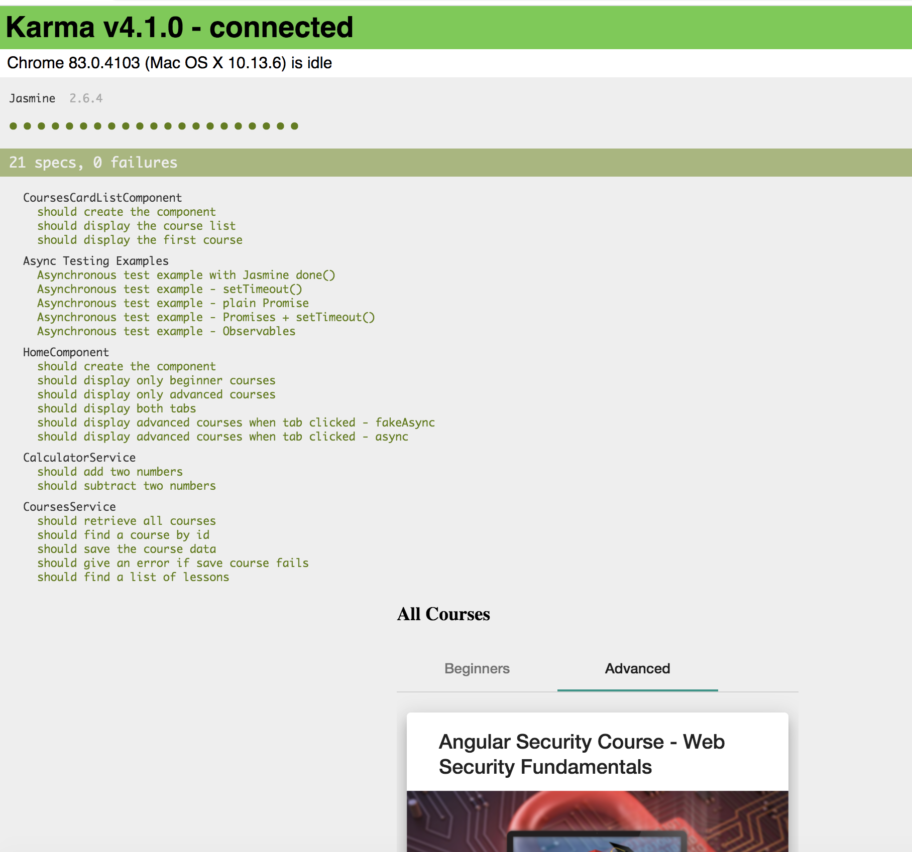

Slide 8
Jest output

Slide 9
Angular Testbed
Testbed uses: Karma/Jasmine OR Jest
https://codecraft.tv/courses/angular/unit-testing/angular-test-bed/

Slide 10

G07- Unit testing

